Slide 1

Inventory Management: A Collaborative Approach
This presentation explores the design and implementation of an inventory management system, focusing on the collaborative interaction of various AI agents to optimize stock control in retail businesses.
Using AI Agents to Manage Software Development Lifecycle
( Waterfall Model )
GROUP - 06
Atharv Rathore - A20595125
Poojith Reddy Annachedu - A20539719
Waseem Pasha Mohammadw - A20551352
Gaurav Acharya - A20583612
ar

Slide 2
Project Overview
Objective
Methodology
The project aims to develop a comprehensive inventory management system for retail businesses, leveraging the power of AI to improve efficiency, reduce costs, and enhance customer satisfaction.
The project follows a waterfall model, systematically progressing through distinct phases.
The project automates tasks such as requirements gathering, system design, development, testing, and documentation.
Key Requirements:
Business Impact:
Real-time inventory tracking
Predicting stock shortages
Automated reordering
Reduced inventory waste
Improved efficiency in stock management
Enhanced decision-making with AI

Slide 3
Project Scope
Key Features:
End Users:
Product browsing and search functionality.
Add to cart and make online payments securely.
Real-time inventory tracking and management.
Automated reordering based on stock levels.
Demand forecasting using historical data analysis.
Generate detailed sales and inventory reports.
Customers: Browse, purchase products, and track orders.
Administrators: Manage inventory, products, and generate reports
Expected Timeline:
The development will take approximately 68 days, divided into phases.

Slide 4


AI Agents and Their Roles:
Customer Proxy Agent: Communicates retailer requirements to the project team.
Project Manager Agent: Creates project plans and coordinates all phases of development.
Requirement Engineer Agent: Documents use cases, requirements, and estimates effort.
System Engineer Agent: Designs system architecture and prepares design documents.
Software Engineer Agent: Develops source code based on design specifications.
Test Engineer Agent: Creates and executes test cases for system validation.
Documentation Engineer Agent: Prepares user guides and training materials.
Hierarchical Role Structure:
[Customer Proxy] → [Project Manager] → [Requirement Engineer] →
[System Engineer] → [Software Engineer] → [Test Engineer] → [Documentation Engineer]

Slide 5
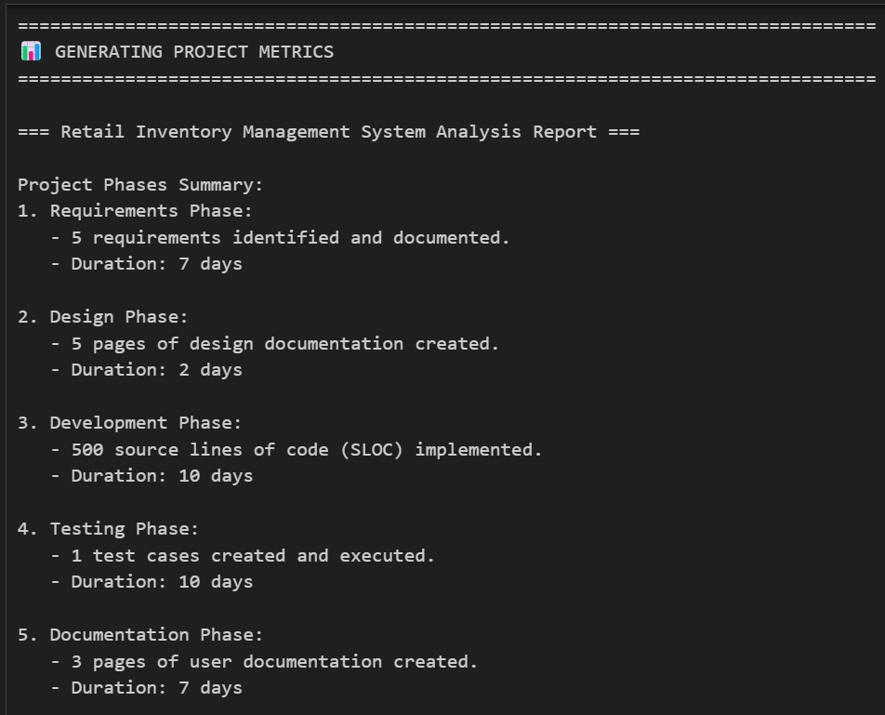
Project Phases in the Waterfall Model:
01
Requirement Gathering: 7 days
02
System Design: 2 days
03
Development: 10 days
04
Testing: 10 days
05
Documentation: 7 days
Requirement Gathering | System Design | Development | Testing | Documentation
7 days | 2 days | 10 days | 10 days | 7 days

Slide 6
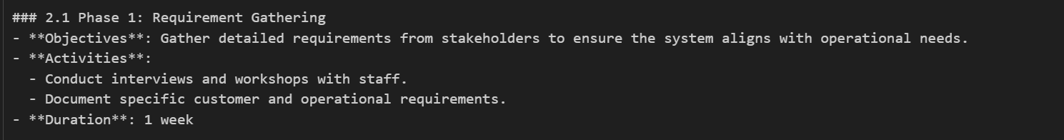
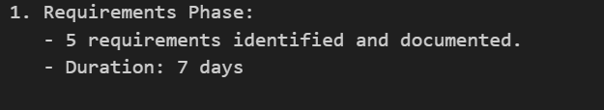
System Requirements and Use Cases
Use Cases:
User Registration: Allows new users to register with email verification and password policies.
User Login: Enables users to securely log in with encrypted credentials.
Product Search: Provides users the ability to search for products by name, category, or price range.
Add to Cart: Users can add products to their shopping cart and review them before checkout.
Checkout: Allows users to provide shipping information, choose payment methods, and complete purchases.
Order History: Enables users to review their past orders, including product details and shipping status.
Requirement Documentation
A total of 6 use cases were identified during the requirement gathering phase.
Each use case contains several detailed requirements, with approximately 5 requirements documented per day.
The requirement gathering phase was completed in 7 days, achieving a productivity rate of 5 requirements/day.
Effort Summary
Total Effort: 7 days
Estimated Productivity: 5 requirements documented daily
Autogen
langgraph

Slide 7
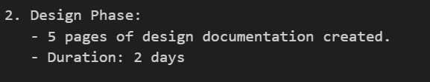
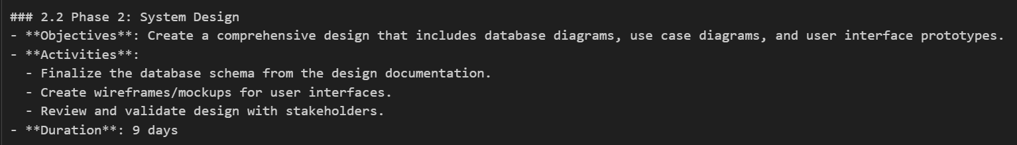
System Design
The System Engineer AI created detailed design documents, including architecture diagrams, database schema, API interaction models, and interface designs.
Output: 10 pages of design documentation were produced, covering high-level architecture, database schema (e.g., tables for products, warehouses, users, orders, suppliers), and key design patterns like Singleton and Observer.
Productivity: Estimated at 5 pages/day.
Effort: The design phase was completed in 2 days, with reviews and feedback incorporated.
langgraph
Autogen

Slide 8
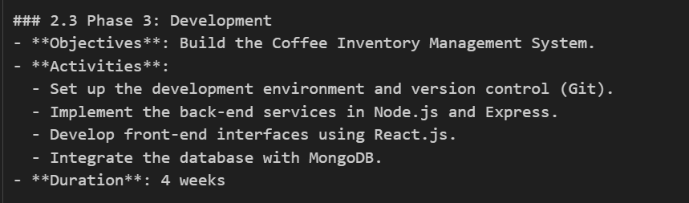
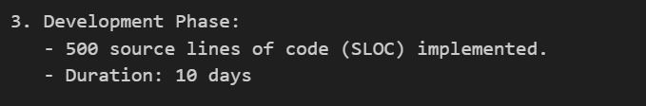
Code Development
Autogen
The Software Engineer AI implemented the source code based on the design documents.
Output: Approximately 500 lines of code (SLOC) were developed across modules.
Productivity: Estimated at 50 SLOC/day.
Effort: The development phase took 10 days, including initial implementation and iterative improvements based on stakeholder feedback.
langgraph

Slide 9
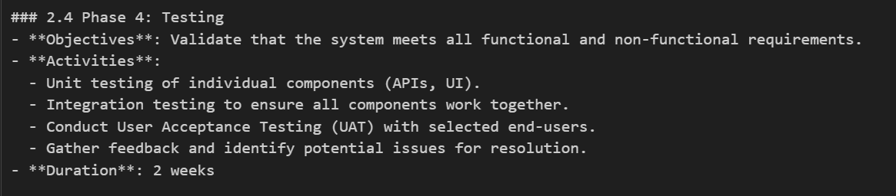
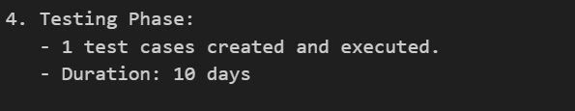
Testing
The Test Engineer AI created and executed test cases based on the requirements and design documents.
Output: A total of 20 test cases were executed, covering functional, non-functional, and integration testing.
Productivity: Estimated at 2 test cases per day.
Effort: The testing phase took 10 days (2 test cases/day × 10 days = 20 test cases executed).
Autogen
langgraph

Slide 10
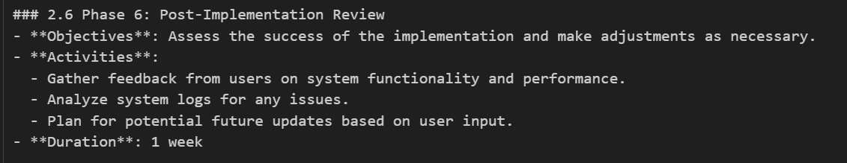
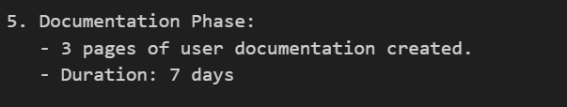
Documentation
Autogen
The Documentation Engineer AI prepared user manuals, technical documentation, and training materials.
Output: A total of 21 pages of documentation were produced, including user guides, troubleshooting steps, and FAQs.
Productivity: Estimated at 3 pages per day.
Effort: The documentation phase was completed in 4 days (3 pages/day × 7 days = 21 pages documented).
langgraph

Slide 11
Milestones and Effort Estimation
Milestones
Requirement Document Completed: Day 7
System Design Document Completed: Day 9
Code Development Completed: Day 10
Testing Completed: Day 29
Effort Estimation
Requirement Gathering: 7 days
System Design: 2 days
Coding: 10 days
Testing: 10 days

Slide 12

Conclusion and Future Enhancements
Outcome:
Successfully developed and tested an AI-powered inventory management system tailored for a coffee retailer, featuring real-time tracking, predictive analytics, and automated reordering.
Demonstrated the effectiveness of AI agents in simulating a real-world development team to execute a software project end-to-end.
Delivered a system capable of optimizing stock levels, reducing holding costs, and improving operational efficiency.
Future Enhancements:
Integrate advanced AI models for more accurate demand forecasting and stock optimization.
Enhance the user interface with customizable dashboards and improved usability features.
Explore IoT integration for real-time inventory updates directly from warehouses, ensuring greater accuracy and efficiency.

